Slide 1


Design Optimization
Optimization of Four Bar Mechanism’s linkages for custom paths
Lavakumar Veludandi -108019275556
Gursimran Singh -108019265806
Herol Lawrence Dsouza -108019265602
Naresh Kothavandla -108019265799

Slide 2
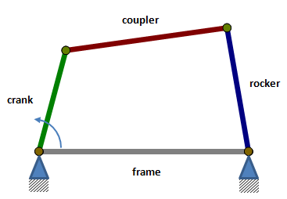

Contents
Introduction
Applications
Design variables
Objective function
Differential Evolution
Topology Optimization
Results
Conclusion

Slide 3
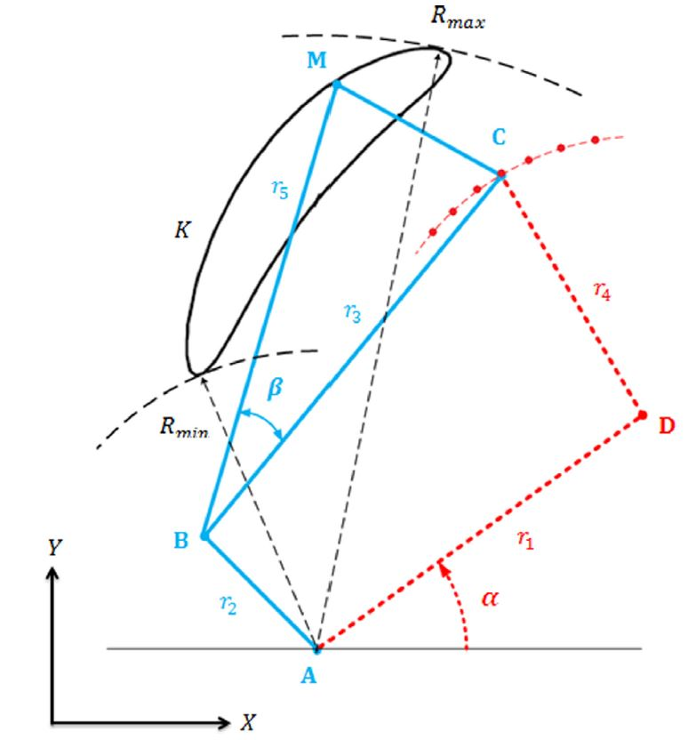
Introduction
How does a four bar mechanism work?
Path generation using precision points.
Drawbacks of analytical methods.
Why optimization methods?
Goals …!!!
Determine the length of the links
Position of fixed points
To generate the desired path
Ternary link
Rocker
Coupler
Frame
Crank
A

Slide 4
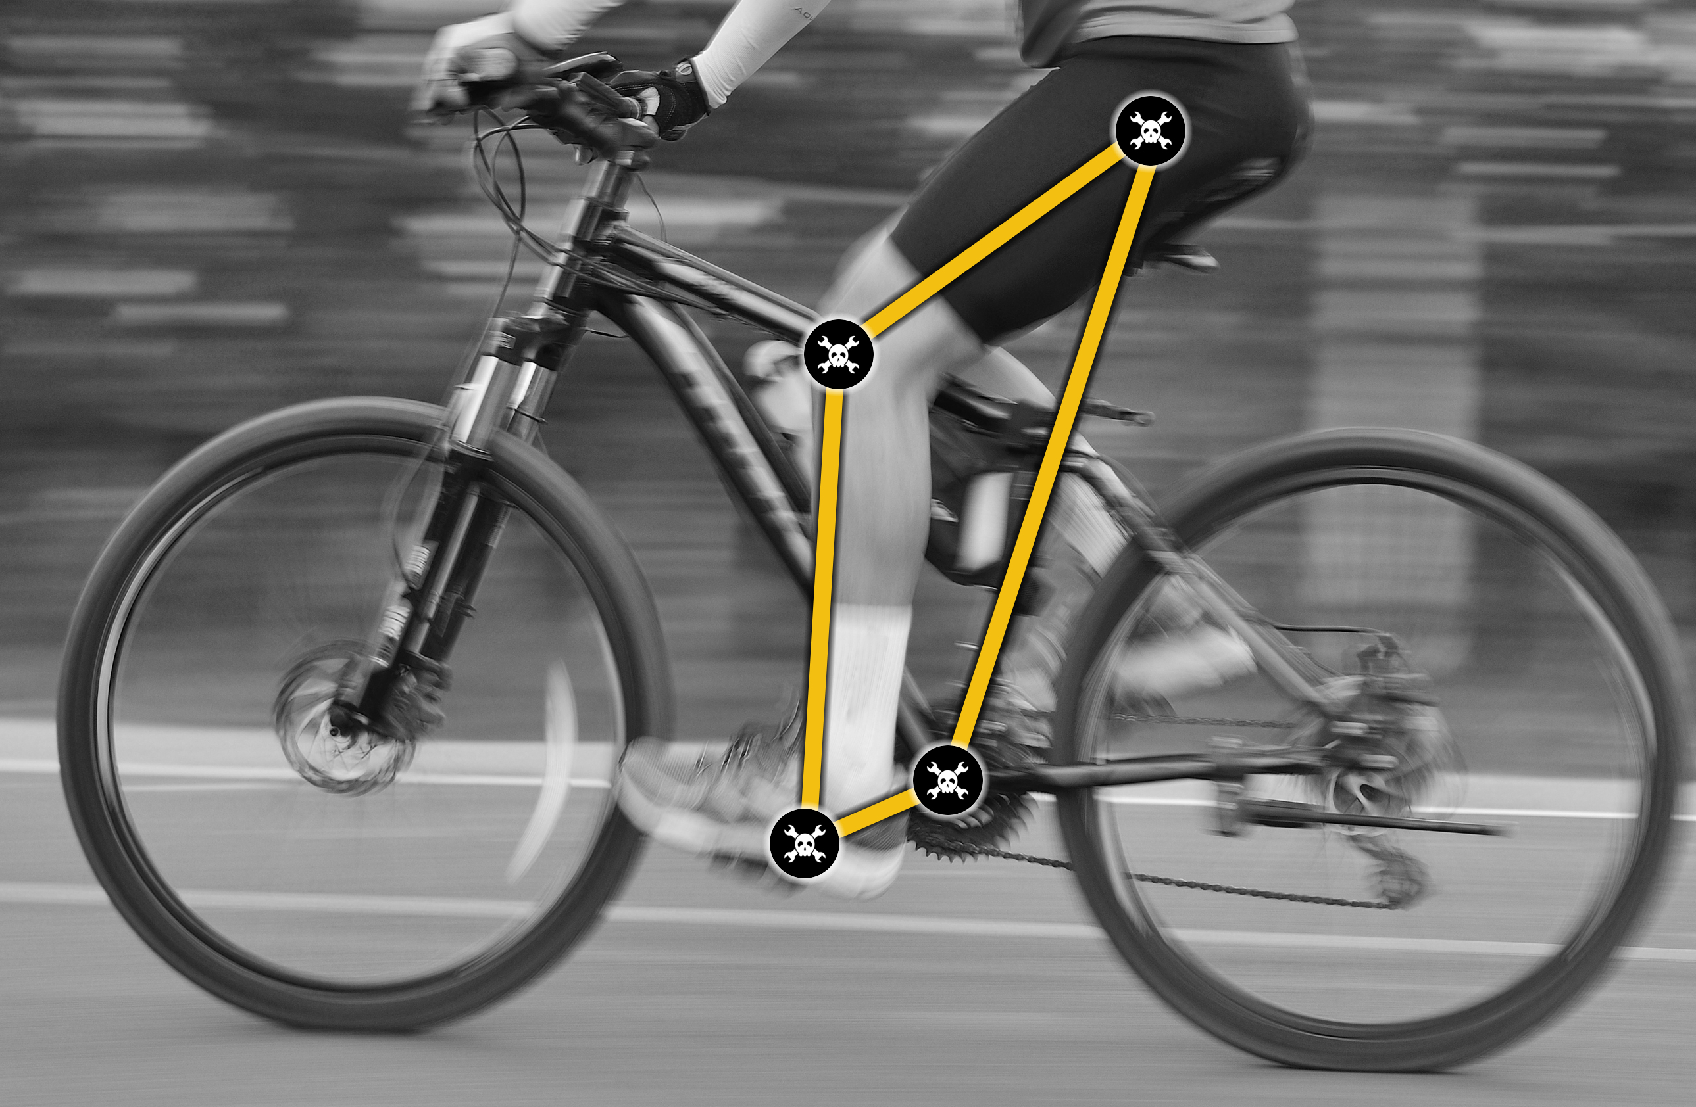
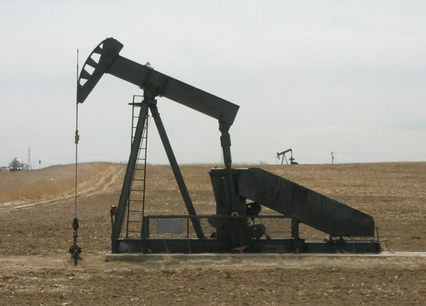
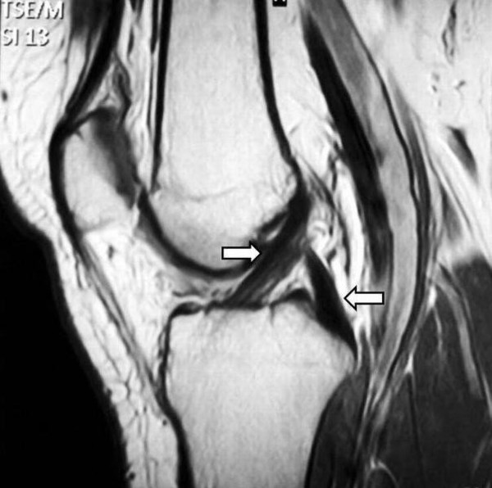
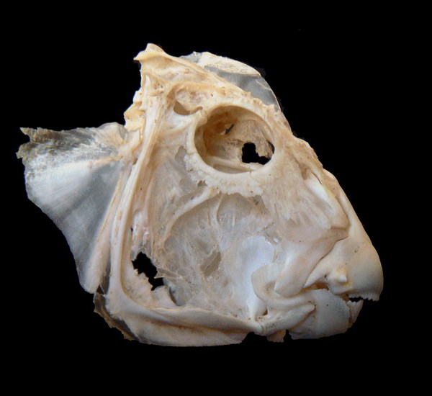
Applications
Bicycle Pedaling
(reciprocal to rotary)
Pumpjack
(rotary to reciprocating)
Image Source:
https://hackaday.com/2017/03/29/
marvelous-mechanisms-the-ubiquitous-four-bar-linkage/
Knee joint
(restricted motion)
Parrot fish jaw
(force multiplication)

Slide 5
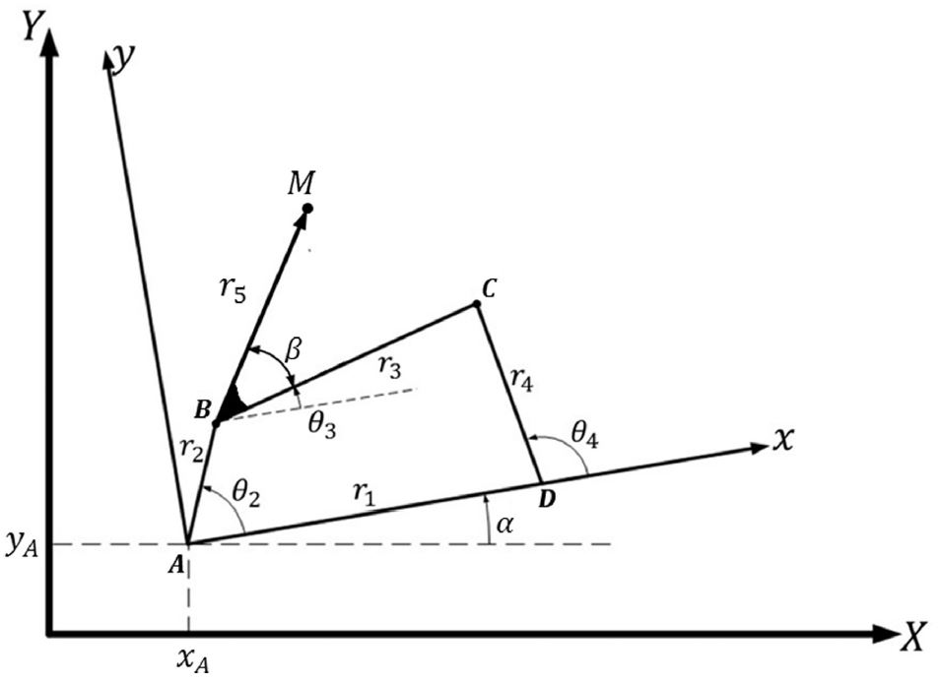
Design variables
Nine design variables
r1, r2, r3, r4, r5, β, xA,yA and α.
Where,
r1, r2, r3 & r4 = lengths of the link.
r5 & β = determines the path.
(xA,yA) & α = position and orientation
of the fixed link.
Four optimization variables xA, yA, r3 & β

Slide 6
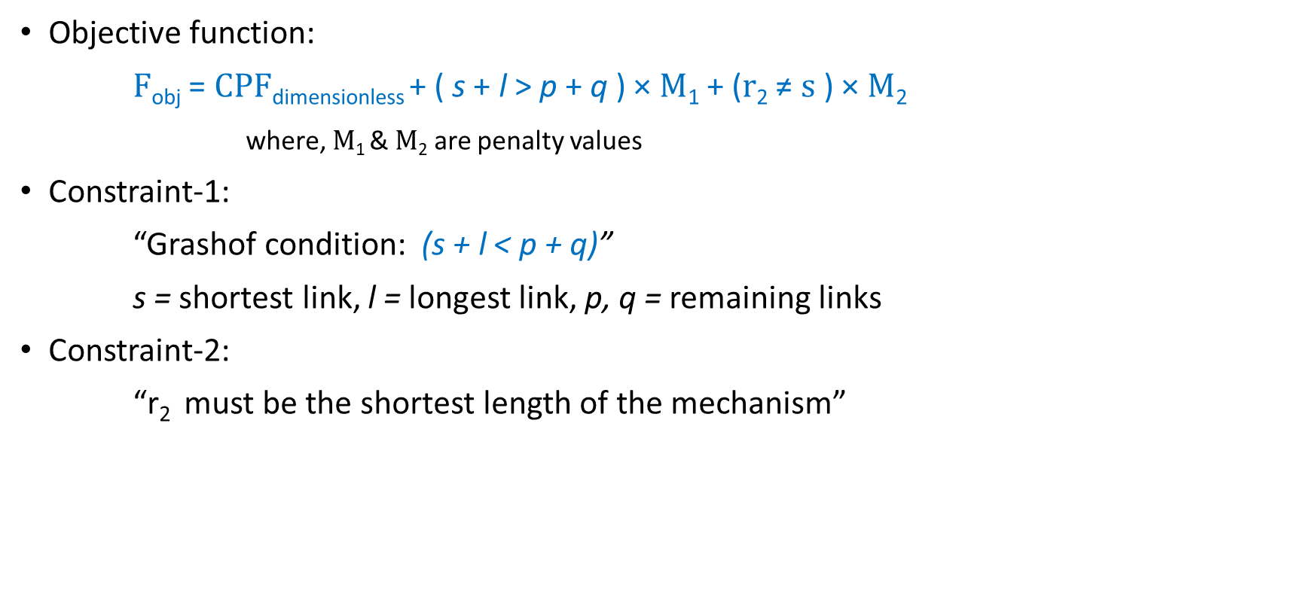
Objective function
Objective function:
$\text{F}\text{obj}$ = $CP\text{F}\text{dimensionless}$+ ( s + l > p + q ) × $\text{M}\text{1}$ + ($\text{r}\text{2}$ ≠ s ) × $\text{M}\text{2}$
where, $\text{M}\text{1}$& $\text{M}\text{2}$ are penalty values
Constraint-1:
“Grashof condition: (s + l < p + q)”
s = shortest link, l = longest link, p, q = remaining links
Constraint-2:
“r₂ must be the shortest length of the mechanism”

Slide 7
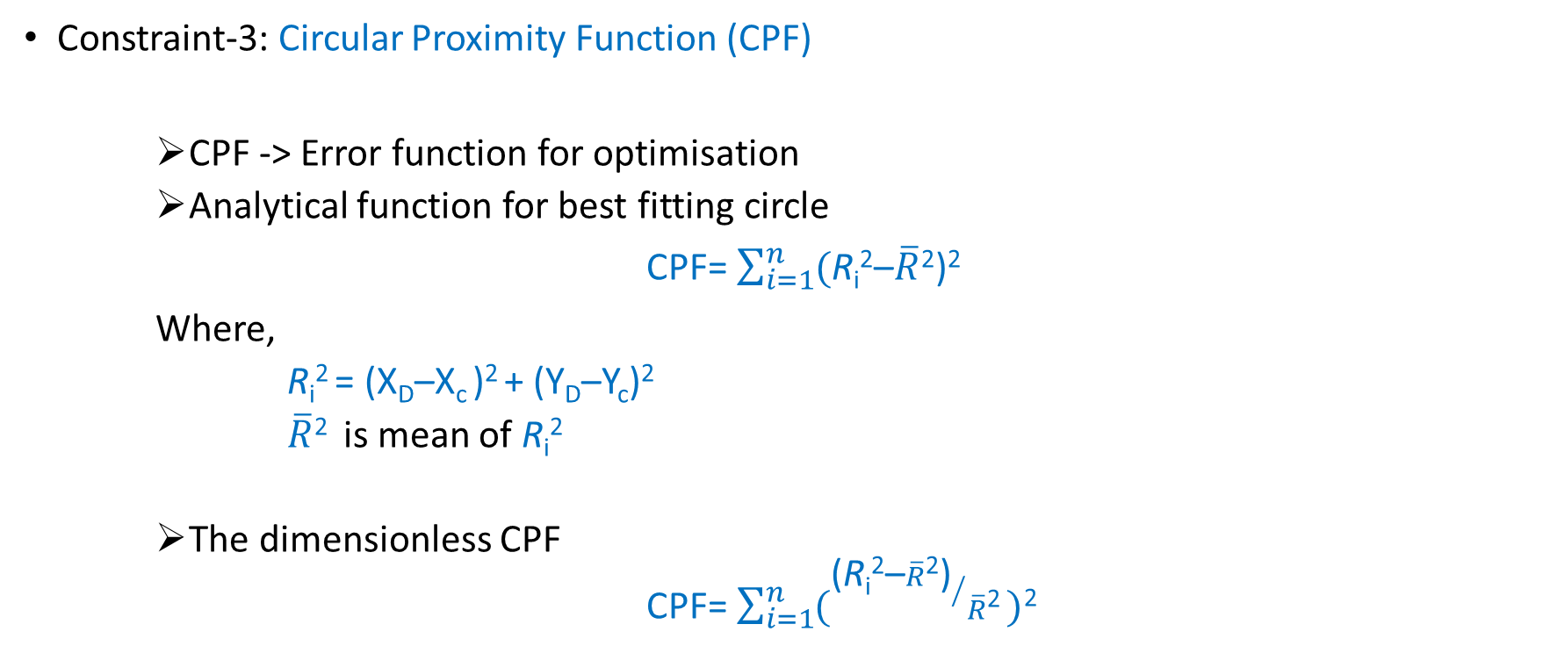
Objective function
Constraint-3: Circular Proximity Function (CPF)
CPF -> Error function for optimisation
Analytical function for best fitting circle
CPF= $\sum_{i=1}^{n}{(}$R_{i}²–$\overline{R}$²)²
Where,
R_{i}² = (X_{D}–X_{c} )² + (Y_{D}–Y_{c})²
$\overline{R}$² is mean of R_{i}²
The dimensionless CPF
CPF= $\sum_{i=1}^{n}{({\text{(}\text{R}\text{i}\text{2}\text{–}\overline{R}\text{2}\text{)}}/{\overline{R}\text{2}}\text{)}}$²
(X_{c} , Y_{c})
(X_{D} , Y_{D})

Slide 8
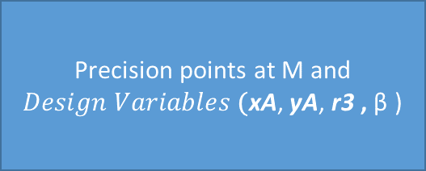
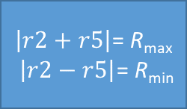
Objective function
Precision points at M and $Design Variables \text{(}\text{xA}\text{, }\text{yA}\text{, }\text{r}\text{3} \text{,} \text{β} \text{)}$
Traced points at C
CPF
Optimized circle at D
$\left|r2+r5\right|$= R_{max}
$\left|r2−r5\right|$= R_{min}
Set of circles for precision points at C.
Computes the point D and the length of r4,r1, inclined angle alpha

Slide 9
Optimization Process
4
Y
5
3
y
Desired Path
2
1
M
After CPF
C
r5
β
r4
D3
r3
D4
B
D1
r2
r1
D
D5
α
D2
yA
A
xA
X

Slide 10
Differential Evolution
User inputs
Objective function
Population size
Lower & Upper bounds
Number of iterations
Crossover probability
Scaling Factor
Stochastic population based technique.
Each solution undergoes mutation followed by recombination.
Greedy selection is performed between target and trial vectors.
Target
Vector
Mutation
Donor
Vector
Recombination
Trial
Vector

Slide 11
Differential Evolution
A matrix of M of size (NP,m) is generated based randomly
M = repmat(lb,Np,1).*rand(Np,D) + repmat((ub-lb),Np,1).*rand(Np,D)
Each entry of M is within the prescribed bounds by the user
Selected X_{r1}
V_{1,1} | V_{1,2} | V_{1,3} | V_{1,4}
V_{2,1} | V_{2,2} | V_{2,3} | V_{2,4}
V_{3,1} | V_{3,2} | V_{3,3} | V_{3,4}
V_{4,1} | V_{4,2} | V_{4,3} | V_{4,4}
V_{1,m}
V_{2,m}
V_{3,m}
V_{4,m}
NP : Population Size
V : Target Vector
D : Length of target vector
lb : Lower Bound
ub : Upper Bound
Target Vector
Selected X_{r2}
V_{NP,1} | V_{NP,2} | V_{NP,3} | V_{NP,4}
V_{NP,m}
Selected X_{r3}

Slide 12
Mutation
Differential Evolution
Donor Vector (V) is created as:
Target vector is not involved in mutation
Total 4 vectors are involved in mutation of target vector, hence
N_{p} is the population size
V = X_{r1} + F (X_{r2} – X_{r3})
F Scaling factor between 0 and 2
X_{r1,r2,r3} Random solutions
N_{p} ≥ 4

Slide 13

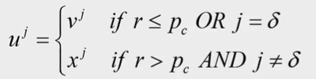
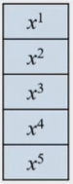
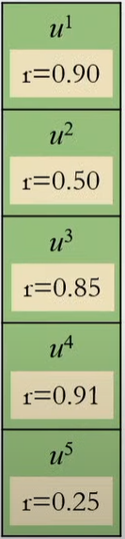
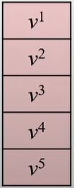
Recombination: Binomial (uniform) crossover
Differential Evolution
Performed to increase the diversity
Example:
Trial Vector
Conditions :
x1
v2
v3
x4
v5
r > p_{c}
r > p_{c}
j ≠ δ
p_{c} crossover probability
δ randomly selected variable location
r random number between 0 and 1
u^{j} j^{th} variable of trial vector
v^{j} j^{th} variable of donor vector
x^{j} j^{th} variable of target vector
Target Vector
r ≤ p_{c}
j ≠ δ
r > p_{c}
r > p_{c}
j = δ
r > p_{c}
Donor Vector
j ≠ δ
r ≤ p_{c}
j ≠ δ

Slide 14
Bounding offspring
Differential Evolution
x_{new}
x_{new}
x_{new}
lb
ub
lb
ub
lb
ub
X_{new} violates upper bound
X_{new} violates lower bound
x_{new}
X_{new} is within bounds
x_{new}
lb
ub
lb
ub
No bounding required
Shift x_{new} to upper bound
Shift x_{new} to lower bound

Slide 15
Greedy Selection
Differential Evolution
D1
D2
D3
D4
D5
x1
x2
x3
x4
x5
Objective Function
Objective Function
λ
μ
Finally: if:
λ > μ Select Trial Vector
λ < μ Select Target Vector
Trial Vector
Target Vector

Slide 16
Process Flowchart
Design Variables
X
Objective Function
Differential Evolution
CPF
Convergence
no
yes
Output

Slide 17
Results Problem 1:
Variable | Optimized Values
r1 | 1.85
r2 | 1.69
r3 | 2
r4 | 1.83
r5 | 4.45
β | 0.16
x_{A} | 1
y_{A} | 4.95
α | -0.27
Units : Lengths : meters
Angles : radians
Total number of precision points: 25

Slide 18
Results Problem 2:
Variable | Optimized Values
r1 | 6.27
r2 | 1.72
r3 | 2.37
r4 | 5.62
r5 | 2.89
β | -0.04
x_{A} | 0
y_{A} | 4.5
α | 2.76
Total number of precision points: 90
Units : Lengths : meters
Angles : radians

Slide 19
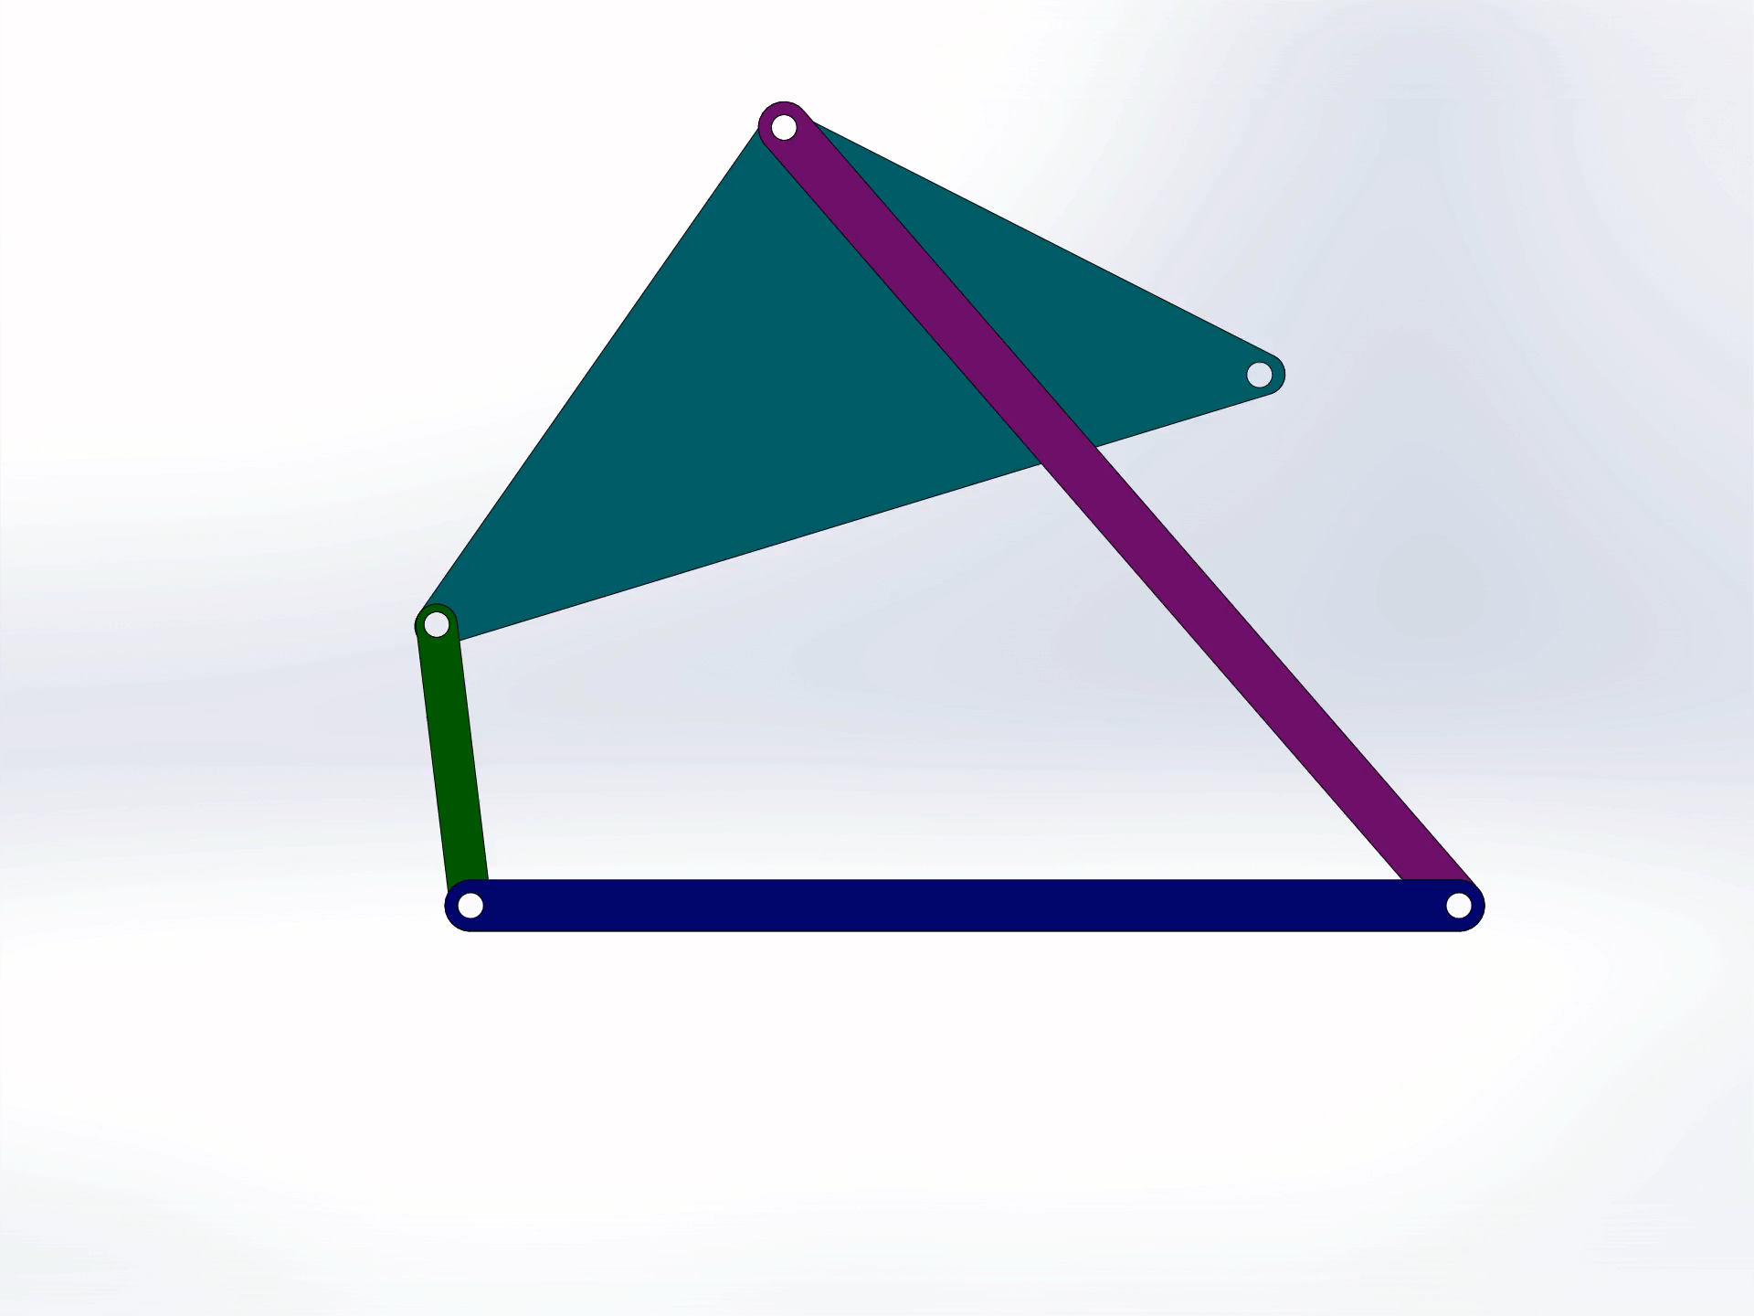

Animation
PROBLEM-1
PROBLEM-2

Slide 20
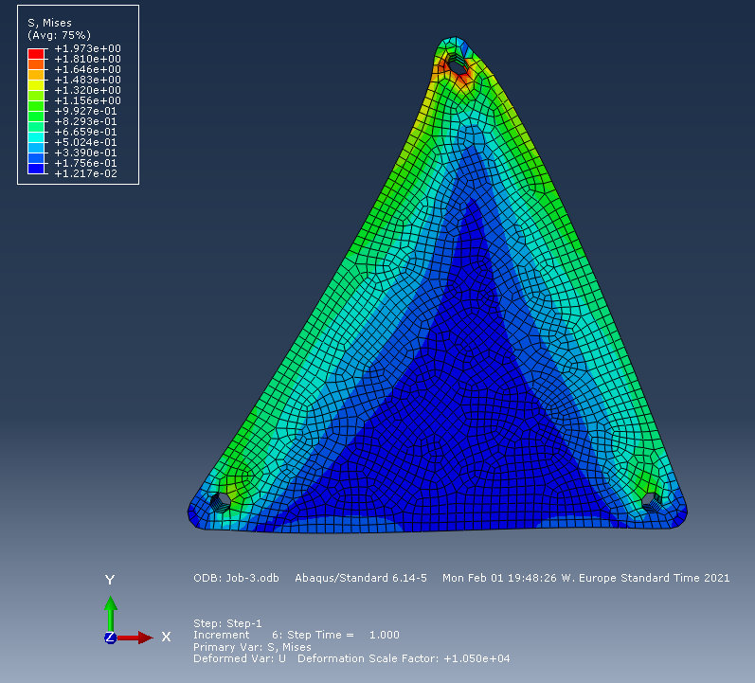
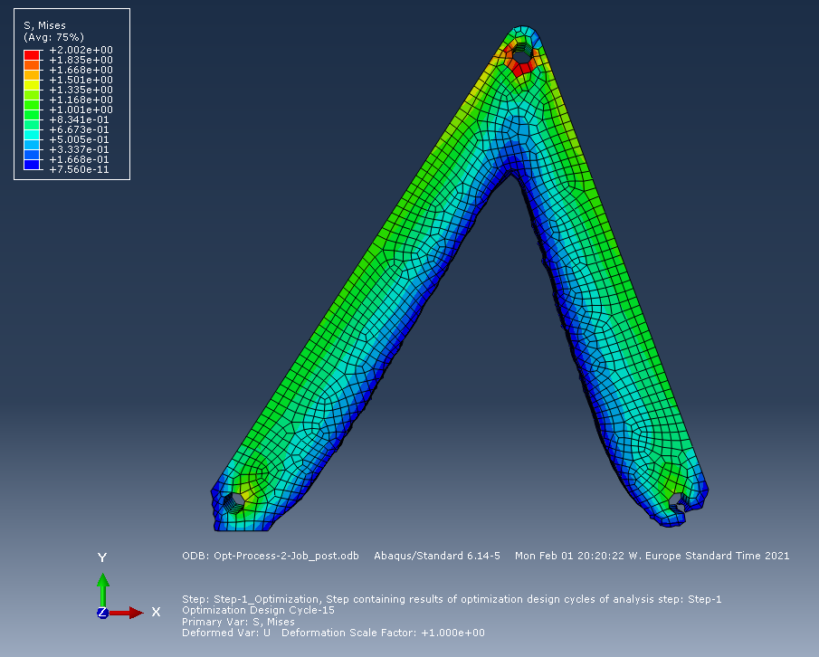
Topology optimization: Problem 1 – Ternary Link
Von-Mises stresses before optimization
Shape of the link as a result of topology optimization
Material : Steel
Young’s modulus: 210 GPA

Slide 21
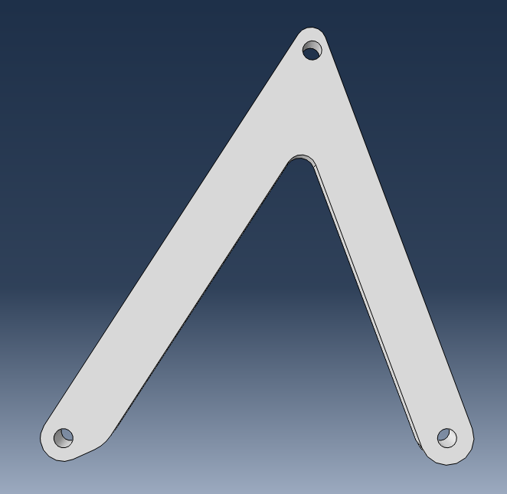
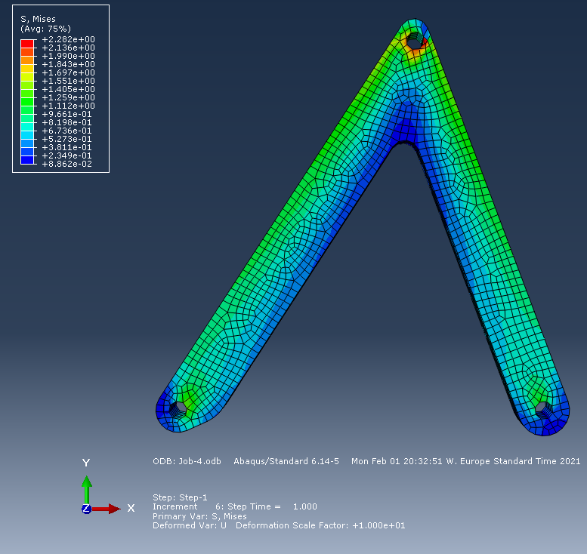
Topology optimization: Problem 1 – Ternary Link
Final shape of the link built based on
topology optimization
Von-Mises stresses of final design of the link

Slide 22
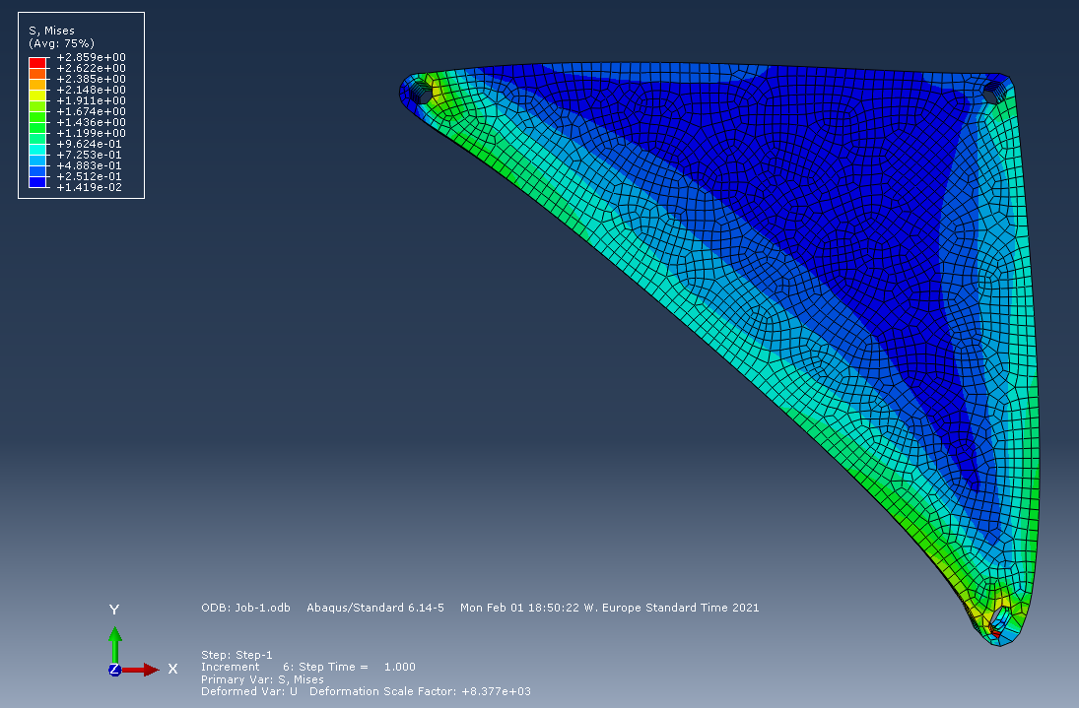
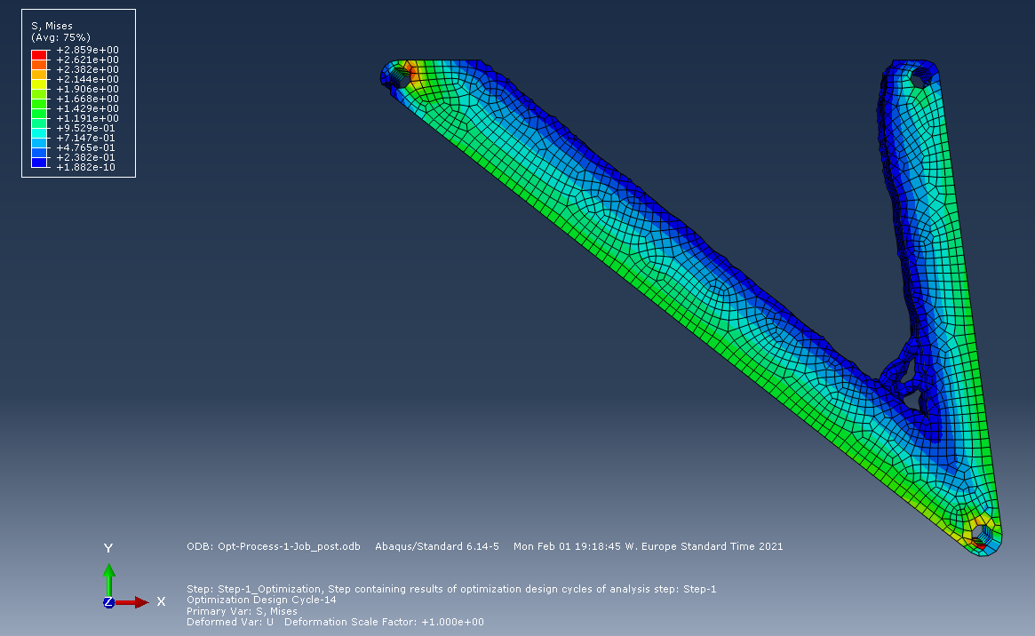
Topology optimization: Problem 2 – Ternary Link
Von-Mises stresses before optimization
Shape of the link as a result of topology optimization
Material : Steel
Young’s modulus: 210 GPA

Slide 23
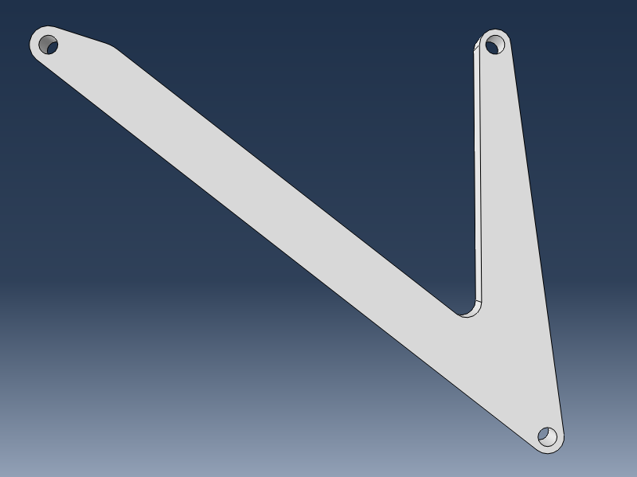
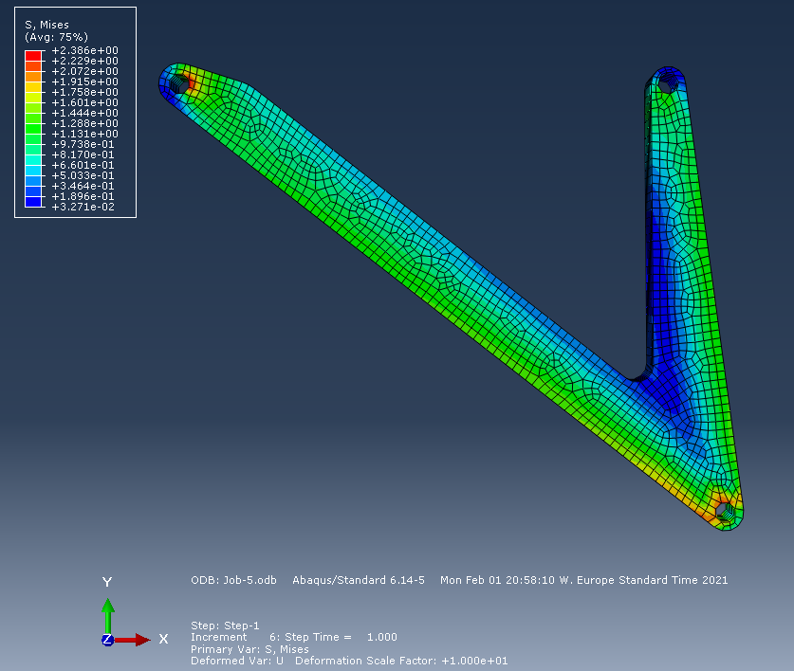
Topology optimization: Problem 2 – Ternary Link
Final shape of the link built basing on
topology optimization
Von-Mises stresses of final design of the link

Slide 24
Conclusions
Optimal synthesis of four-bar path generation of linkages.
Design Variables reduced from 9 to 4 using CPF.
50% volume reduction of the Ternary Link using TO in ABAQUS.
Applications: Milling machines.
Future Scope: Implementation using Neural Networks.
Pros: 1) Huge dataset of precision points.
2) Increased precision of traced path.

Slide 25
References
Sahand Hadizadeh Kafash , Ali Nahvi, Optimal synthesis of four-bar path generator linkages using Circular Proximity Function, 2017.
A.J. Sommese , Complete solution of the nine-point path synthesis problem for four-bar linkages, J. Mech. Des. 114 (1992) 153.
G.P. Roston , R.H. Sturges , Genetic algorithm synthesis of four-bar mechanisms, Artif. Intell. Eng. Des. Anal. Manuf. 10 (1996) 371–390.
S.H. Kafash , A. Nahvi , Optimal synthesis of four-bar motion generator linkages using circular proximity function, Proc. Inst. Mech. Eng. Part C (2017) 892–908.
S.B. Matekar , G.R. Gogate , Optimum synthesis of path generating four-bar mechanisms using differential evolution and a modified error function, Mech. Mach. Theory 52 (2012) 158–179.

Slide 26
Thank You for your kind attention…

